Slide 1

Day - 2

Slide 2
Queues
The Queue interface is present in java.util package and extends the Collection interface is used to hold the elements about to be processed in FIFO(First In First Out) order.
The Queue interface provides several methods for adding, removing, and inspecting elements in the queue. Here are some of the most commonly used methods:
add(element): Adds an element to the rear of the queue. If the queue is full, it throws an exception.

Slide 3
offer(element): Adds an element to the rear of the queue. If the queue is full, it returns false.
remove(): Removes and returns the element at the front of the queue. If the queue is empty, it throws an exception.
poll(): Removes and returns the element at the front of the queue. If the queue is empty, it returns null.
element(): Returns the element at the front of the queue without removing it. If the queue is empty, it throws an exception.
peek(): Returns the element at the front of the queue without removing it. If the queue is empty, it returns null.

Slide 4
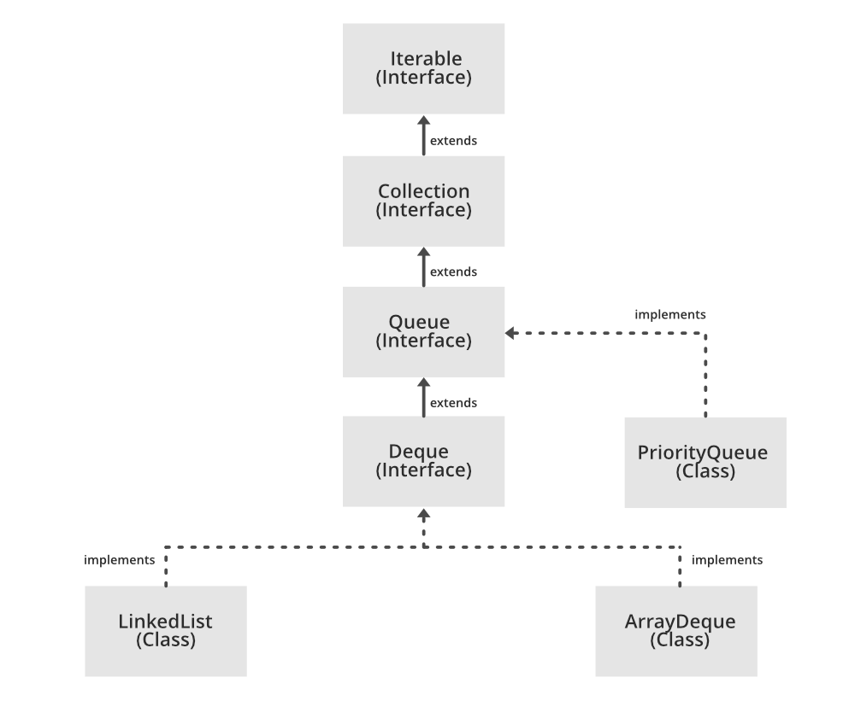
The Queue interface is implemented by several classes in Java, including LinkedList, ArrayDeque, and PriorityQueue.

Slide 5
Priority Queue
Priority queue is a new abstract data type that allows arbitrary element insertion and allows the removal of the element that has first priority.
When an element is added to a priority queue, the user designates its priority by providing an associated key

Slide 6
The Priority Queue ADT
insert(k, v): Creates an entry with key k and value v in the priority queue.
min( ): Returns (but does not remove) a priority queue entry (k,v)
having minimal key; returns null if the priority queue is empty.
removeMin( ): Removes and returns an entry (k,v) having minimal key from the priority queue; returns null if the priority queue is empty.
size( ): Returns the number of entries in the priority queue.
isEmpty( ): Returns a boolean indicating whether the priority queue is empty.

Slide 7
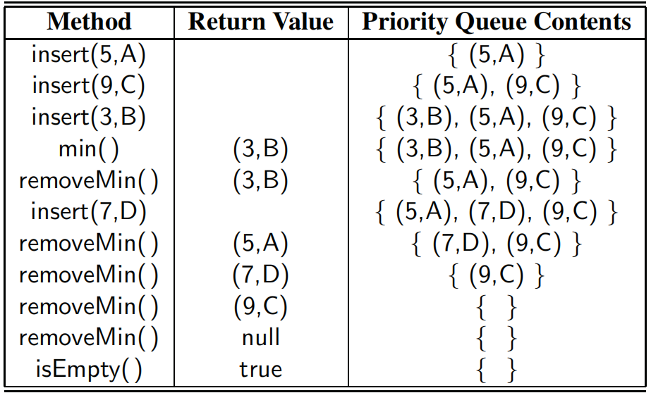

Slide 8
The Comparator Interface
In some applications, we may want to compare objects according to some notion other than their natural ordering. For example, we might be interested in which of two strings is the shortest, or in defining our own complex rules for judging which of two stocks is more promising.
To support this, Java defines the java.util.Comparator interface. A comparator is an object that is external to the class of the keys it compares.

Slide 9
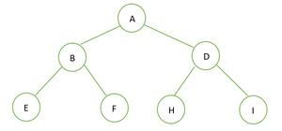
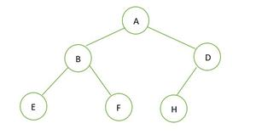
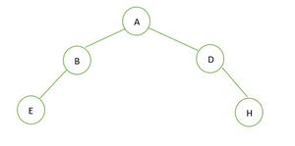
Complete binary tree
A complete binary tree is a binary tree in which every level, except possibly the last, is completely filled, and all nodes in the last level are as far left as possible.
Complete Binary Tree
Not a Complete Binary Tree

Slide 10
Heaps
Heap data structure is a complete binary tree that satisfies the heap property, where any given node is
always greater than its child node/s and the key of the root node is the largest among all other nodes. This property is also called max heap property.
always smaller than the child node/s and the key of the root node is the smallest among all other nodes. This property is also called min heap property.

Slide 11
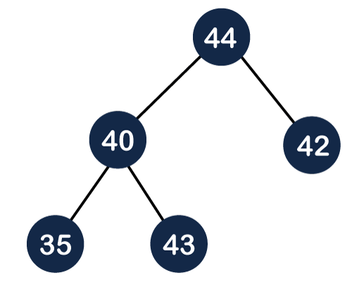
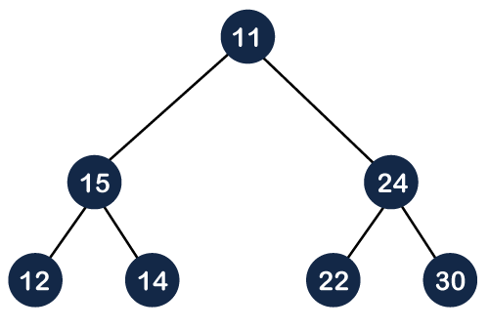
Min Heap
Max Heap

Slide 12
Implementing a Priority Queue with a heap
Adding an Entry to the Heap
Let us consider how to perform insert(k, v) on a priority queue implemented with a heap T
We store the pair (k,v) as an entry at a new node of the tree
To maintain the complete binary tree property, that new node should be placed at a position p just beyond the rightmost node at the bottom level of the tree, or as the leftmost position of a new level, if the bottom level is already full

Slide 13
After this action, the tree T is complete, but it may violate the heap-order property.
Lets denote p’s parent as q.
If key kp ≥ kq, the heap-order property is satisfied and the algorithm terminates.
If instead kp < kq, then we need to restore the heap-order property, which can be locally achieved by swapping the entries stored at positions p and q.
The upward movement of the newly inserted entry by means of swaps is conventionally called up-heap bubbling.

Slide 14
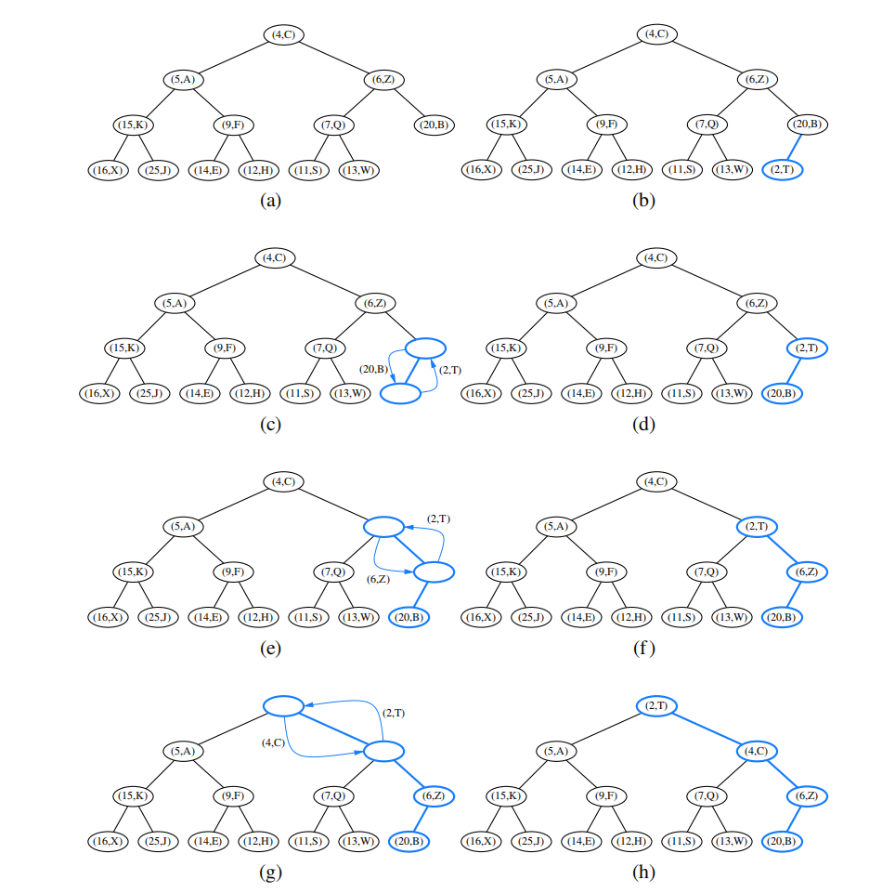

Slide 15
Removing the Entry with Minimal Key
Let us now turn to method removeMin of the priority queue ADT. We know that an entry with the smallest key is stored at the root r of T
We cannot simply delete node r, because this would leave two disconnected subtrees.
We ensure that the shape of the heap respects the complete binary tree property by deleting the leaf at the last position p of T.

Slide 16
If T has only one node (the root), then the heap-order
property is trivially satisfied and the algorithm terminates. Otherwise, we distinguish two cases, where p initially denotes the root of T:
• If p has no right child, let c be the left child of p.
• Otherwise (p has both children), let c be a child of p with minimal key
If key kp ≤ kc, the heap-order property is satisfied and the algorithm terminates. If instead kp > kc, then we need to restore the heap-order property. This can be locally achieved by swapping the entries stored at p and c.
This downward swapping process is called down-heap bubbling.

Slide 17
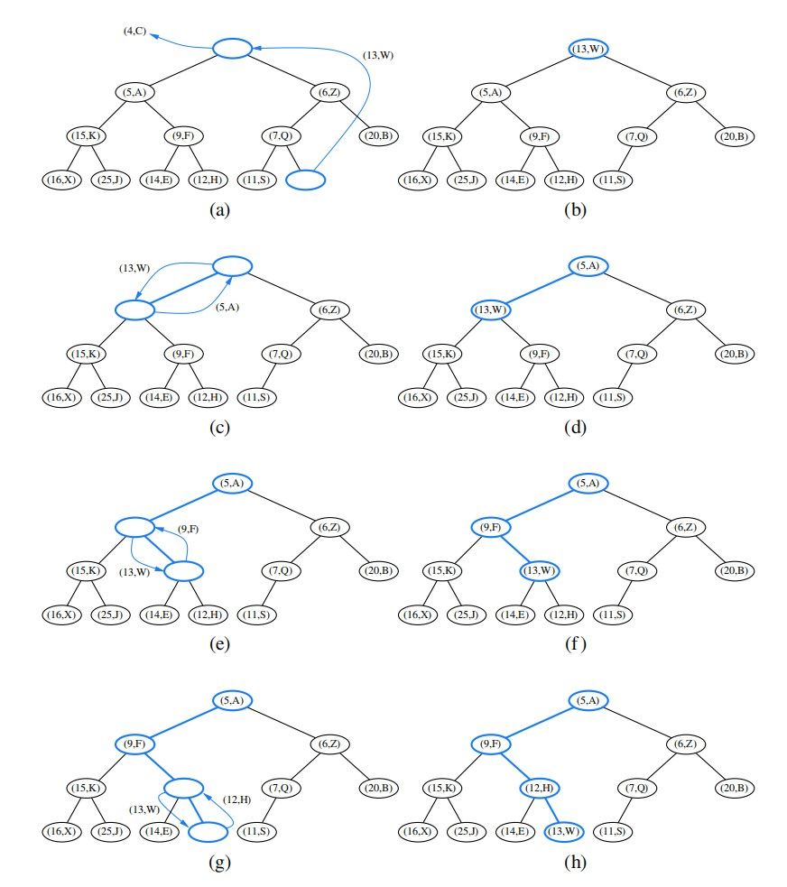

Slide 18
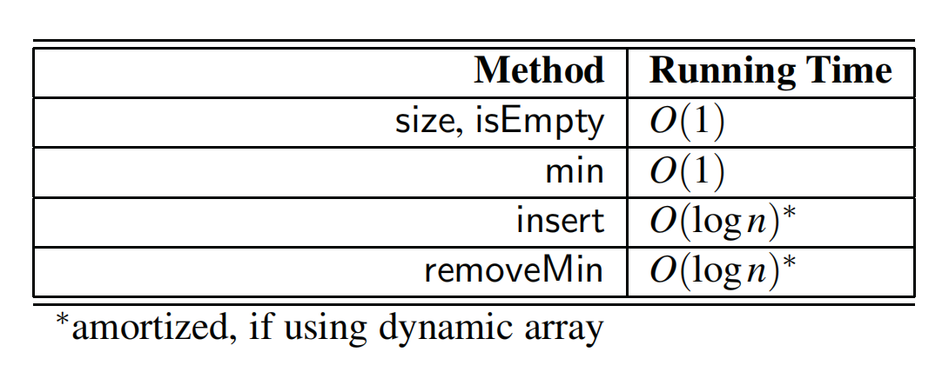
Analysis of Heap Based Priorirty Queue

Slide 19
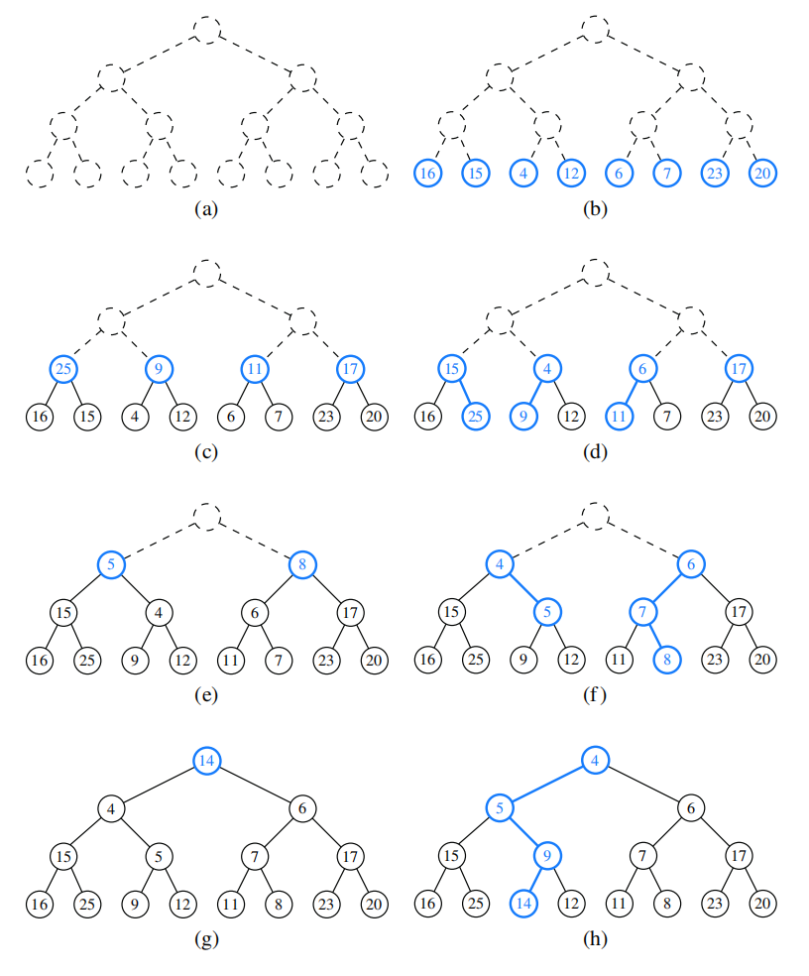
Bottom Up Heap Construction

